Slide 1
Depending on Christ
Acts 15

Slide 2
Acts 15:1-11
1 Certain people came down from Judea to Antioch and were teaching the believers: “Unless you are circumcised, according to the custom taught by Moses, you cannot be saved.” 2 This brought Paul and Barnabas into sharp dispute and debate with them. So Paul and Barnabas were appointed, along with some other believers, to go up to Jerusalem to see the apostles and elders about this question. 3 The church sent them on their way, and as they traveled through Phoenicia and Samaria, they told how the Gentiles had been converted. This news made all the believers very glad. 4 When they came to Jerusalem, they were welcomed by the church and the apostles and elders, to whom they reported everything God had done through them.

Slide 3
Acts 15:1-11
5 Then some of the believers who belonged to the party of the Pharisees stood up and said, “The Gentiles must be circumcised and required to keep the law of Moses.”
6 The apostles and elders met to consider this question. 7 After much discussion, Peter got up and addressed them: “Brothers, you know that some time ago God made a choice among you that the Gentiles might hear from my lips the message of the gospel and believe. 8 God, who knows the heart, showed that he accepted them by giving the Holy Spirit to them, just as he did to us. 9 He did not discriminate between us and them, for he purified their hearts by faith. 10 Now then, why do you try to test God by putting on the necks of Gentiles a yoke that neither we nor our ancestors have been able to bear? 11 No! We believe it is through the grace of our Lord Jesus that we are saved, just as they are.”

Slide 4
Acts 15:22-29
Then the apostles and elders, with the whole church, decided to choose some of their own men and send them to Antioch with Paul and Barnabas. They chose Judas (called Barsabbas) and Silas, men who were leaders among the believers. With them they sent the following letter:
The apostles and elders, your brothers,
To the Gentile believers in Antioch, Syria and Cilicia:
Greetings.
We have heard that some went out from us without our authorisation and disturbed you, troubling your minds by what they said. So we all agreed to choose some men and send them to you with our dear friends Barnabas and Paul — men who have risked their lives for the name of our Lord Jesus Christ. Therefore we are sending Judas and Silas to confirm by word of mouth what we are writing. It seemed good to the Holy Spirit and to us not to burden you with anything beyond the following requirements: You are to abstain from food sacrificed to idols, from blood, from the meat of strangled animals and from sexual immorality. You will do well to avoid these things.
Farewell.

Slide 5
Introducing Acts 15
The Jerusalem conference - church leaders met to discuss whether or not gentile Christians needed to be circumcised
They concluded that gentiles did not need to be circumcised, but they gave them four recommendations for how they ought to live
These four recommendations are linked to Leviticus 17 and 18
These are recommendation not laws
Acts 15 teaches us essential truths about the gospel

Slide 6
The Gospel leads to…
Liberty - we are unburdened
Community - we are equipped to live in unity with one another
Purity - we are made clean by the blood of Jesus

Slide 7
Liberty
The gospel starts by taking all burdens off
Acts 15 v.11 we are saved by grace
Starting from Acts 15, Christians have often slipped into Jesus plus…, the gospel is great, but you also have to do this
If we lose our grip on the gospel of grace, we start thinking we are made righteous by other means and we become burdened

Slide 8
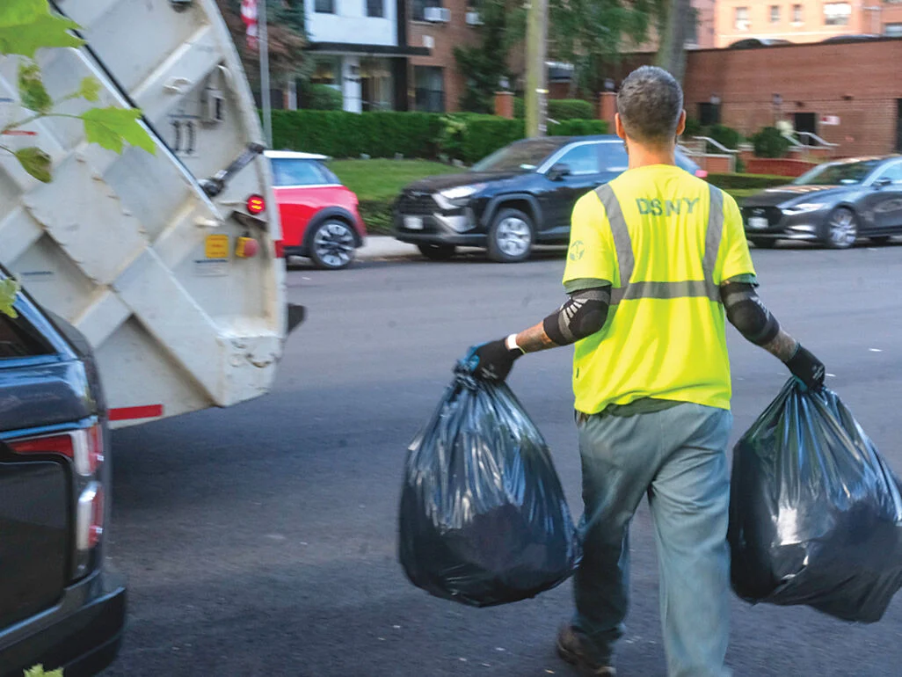
What might our burden be?
The burden of
  proving yourself
  of the past, guilt, regret
  of the future, that you won’t meet standards
  of deciding what you want to be, and meeting that at all costs
Do you carry a burden that Christ hasn’t given you?

Slide 9
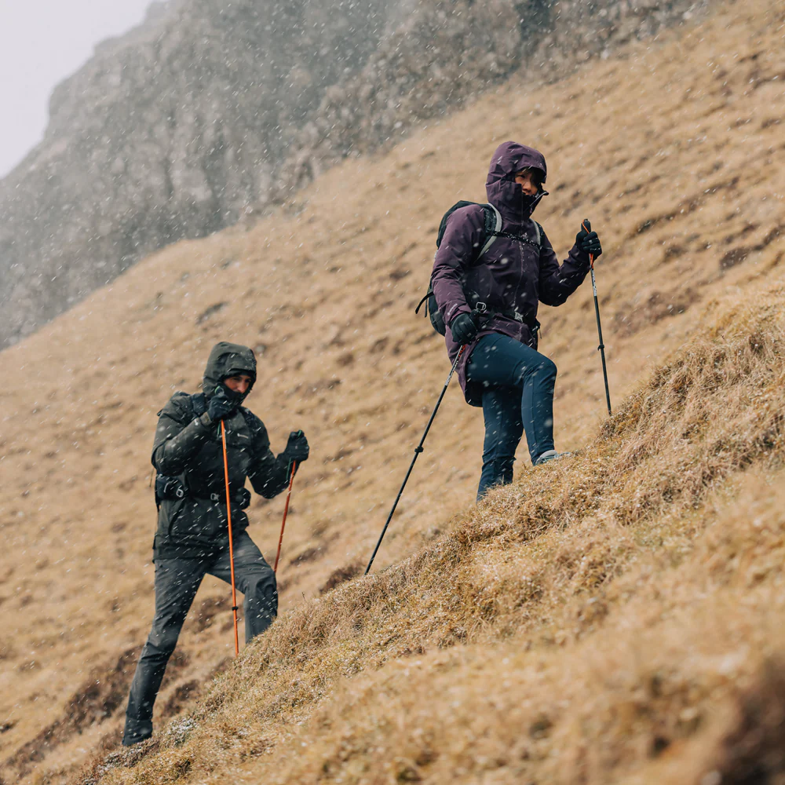
Use your freedom for good

Slide 10
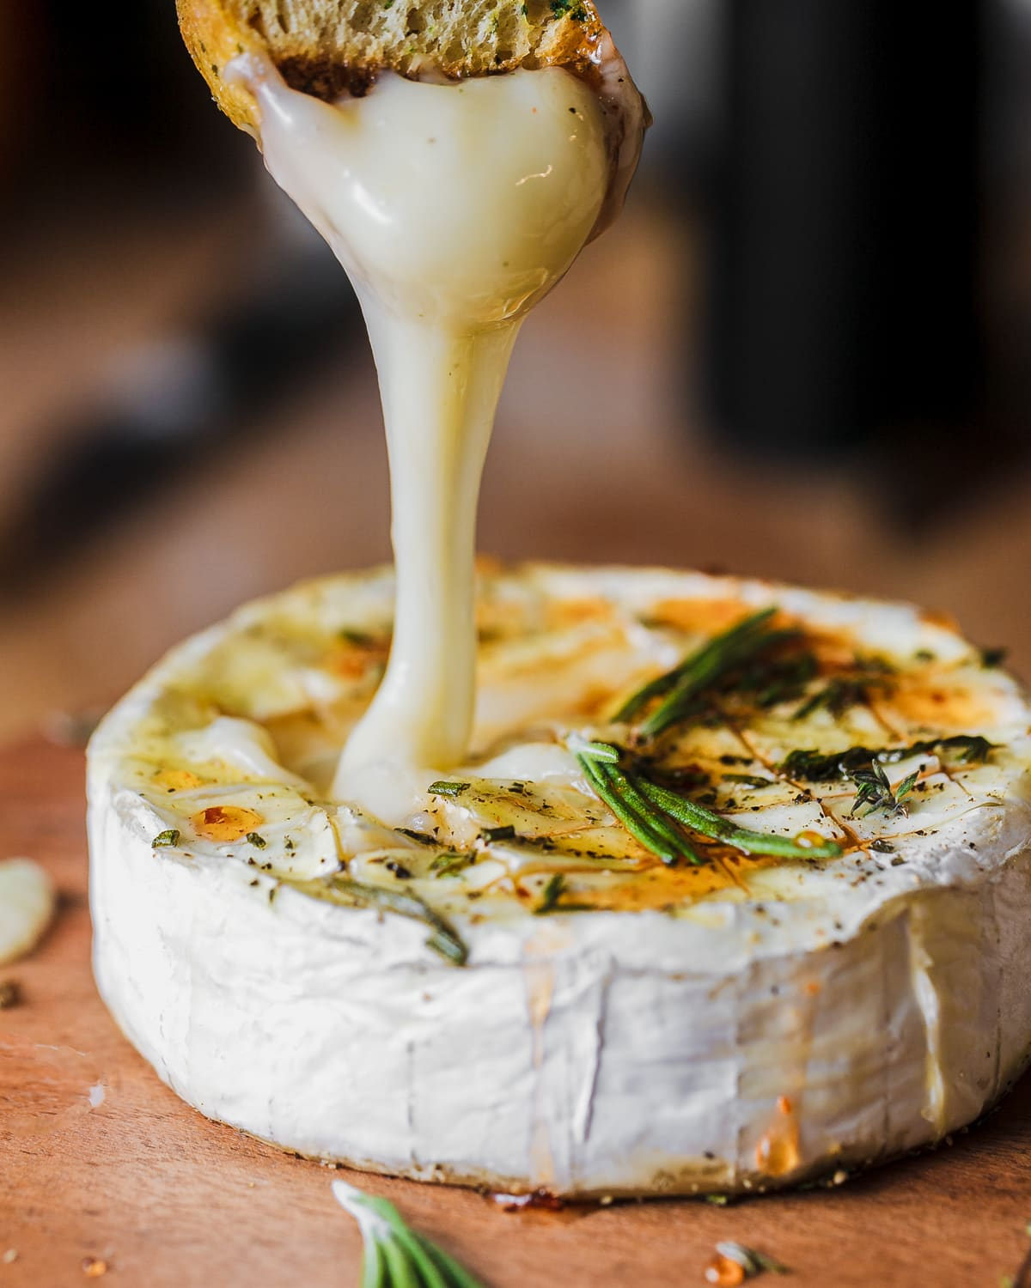
Romans 14 – love and unity is more important than what you eat
If our job is to present each other mature – then we don’t want these minor things to become a barrier to our mission
Gal 5:13 You, my brothers and sisters, were called to be free. But do not use your freedom to indulge the flesh; rather, serve one another humbly in love.

Slide 11
2. The Gospel leads to community
Tim Keller – the human heart never misses chance for self-righteousness
It is through his grace that we can live in unity together
Acts 15 v.28 It seemed good to the Holy Spirit and to us
We may think the pharisees are narrow minded, but we all have this tendency to think we are superior
We want God to so implant the gospel into our hearts that we become curious not judgemental

Slide 12


Slide 13
3. The Gospel leads to purity
The levitical law points to the need for blood/sacrifices/a scapegoat for us saved
In Acts 15 Peter says “[God] purified [the gentiles’] hearts by faith”
Even though they are breaking the levitical law, they are called pure
Circumcision was a representation of the consequences of disobedience to God
Colossians 2:11 - In him you were also circumcised with a circumcision not performed by human hands. Your whole self ruled by the flesh was put off when you were circumcised by Christ.
Jesus was the sacrifice that the levitical law was pointing to
It is not that we ignore Leviticus, but it is that the Bible itself tell us that we no longer need to live under the law because Jesus has come

Slide 14
The Gospel leads to…
Liberty - we are unburdened
Community - we are equipped to live in unity with one another
Purity - we are made clean by the blood of Jesus

Slide 15
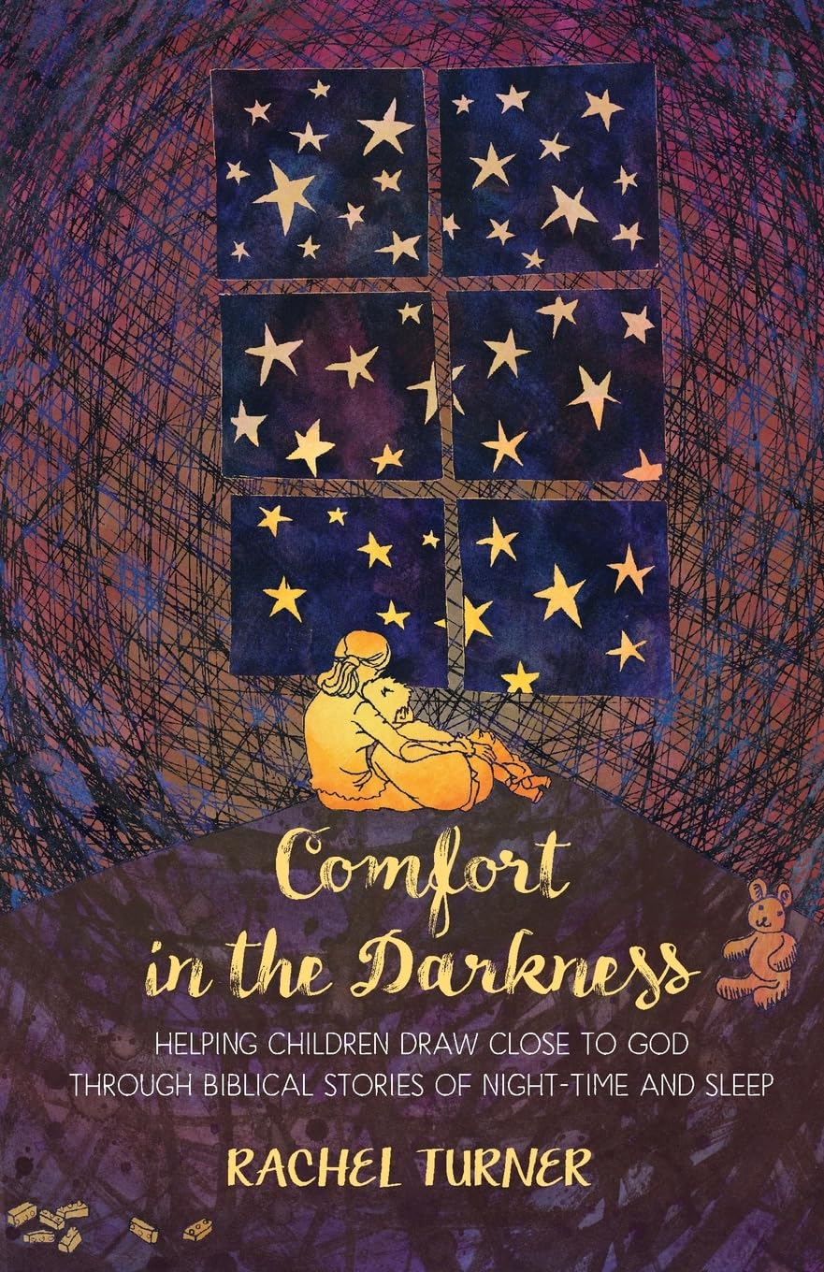
It is through grace that we are saved
Acts 15:11 it is through the grace of our Lord Jesus Christ that we are saved
God has designed us for intimacy with him, for dependence on him
Reflection questions
Why was Iru worried about not having food? What did God say he was going to do?
Why do you think God told the people only to take enough for the day not to try to keep loads for the future?

Slide 16
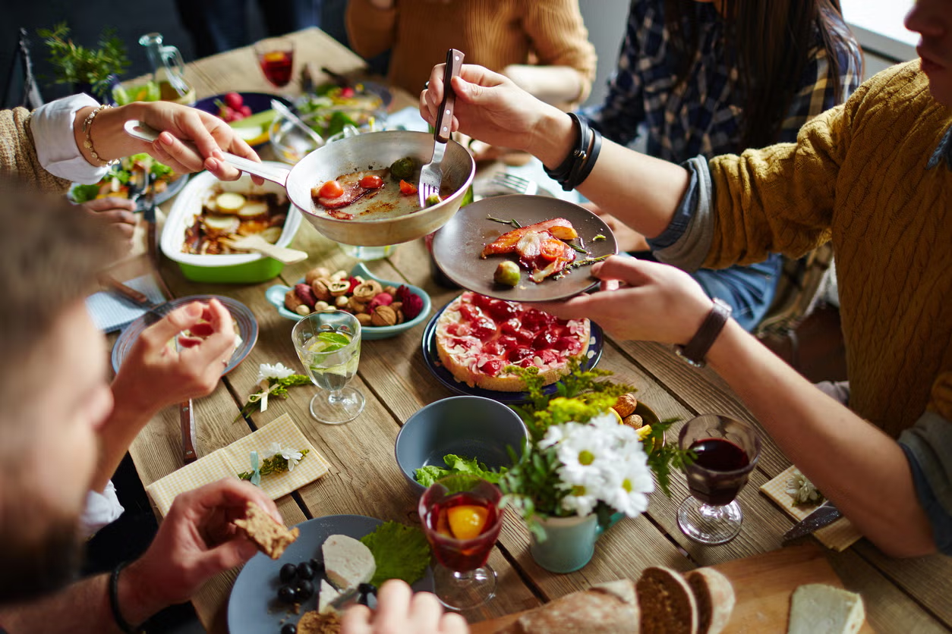
Dependency requires relationship
God wants us to trust him and come to him daily for everything we need - salvation, grace, peace, wisdom

Slide 17
Acts 15 reflections
Liberty - are you burdened?
Community - are you living in unity with others?
Purity - do you know that God has made you clean?
How can you live a life more dependent on Him?

