Slide 1

Ministering the Spirit
Sunday 12th February

Slide 2
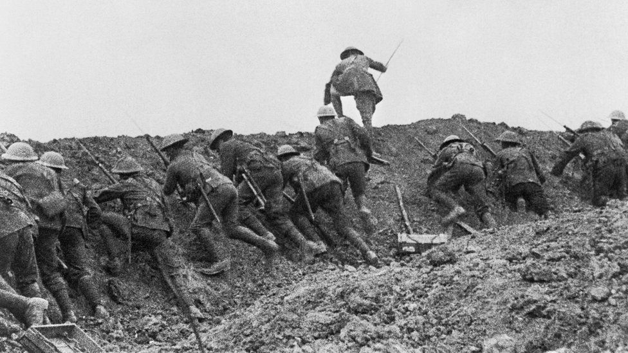

Households Together with Christ at the Centre
The Battle Cry
Sunday 29th January
Sunday 5th February
5th February 2023

Slide 3
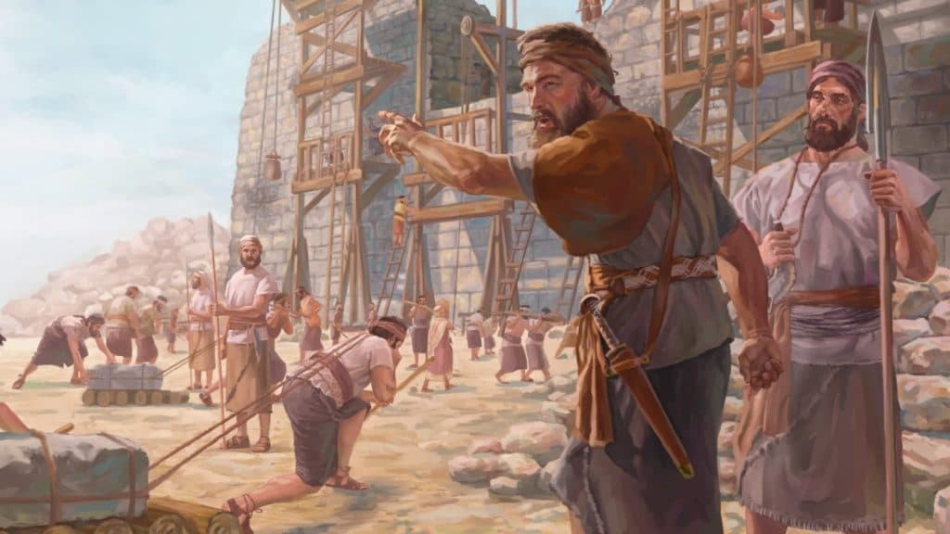
Our Great Project

Slide 4
Our Great Project
Households together with Christ at the centre
Ministering the Spirit
Sharper witness

Slide 5
Defining
Ministering the Spirit
Naturally operating in supernatural gifts which
  strengthen the church
  awaken a hunger in the lost
Increased of awareness & submission to the Spirit
Able to show not just describe God
The Spirit enables us to believe God’s promises
New authority from realising the Spirit within is breaking out

Slide 6
Ministering the Spirit
Naturally operating in supernatural gifts which strengthen the church and awaken a hunger for Jesus in the lost (via miracles and healing etc).
    Awaken hunger in lost
        Jesus & woman at the well
        Peter
          Act 2:37 When the people heard this, they were cut to the heart and said to Peter and the other apostles, “Brothers, what shall we do?”
        Tanya
Notes:
Strengthening the church
Ananias and Sapphira (Acts 5:1-14)
Prediction of famine (Act 11:28-30)
Timothy supernaturally empowered to lead
Sabbatical

Slide 7
Ministering the Spirit
Naturally operating in supernatural gifts which strengthen the church and awaken a hunger for Jesus in the lost (via miracles and healing etc).
    Strengthening the church
        Ananias and Sapphira (Acts 5:1-14)
        Prediction of famine (Act 11:28-30)
        Timothy empowered to lead
        Sabbatical
Notes:
Strengthening the church
Ananias and Sapphira (Acts 5:1-14)
Prediction of famine (Act 11:28-30)
Timothy supernaturally empowered to lead
Sabbatical

Slide 8
Ministering the Spirit
Increased ability to be led by His spirit (awareness & submission)
    Gen 28:16 “Surely the Lord is in this place, and I was not aware of it.”
      He is already here! We want to become aware
    Acts 11 (famine)
      as soon as they heard they acted
    E.g. Norma phone call
    E.g. Italian earthquake

Slide 9
Ministering the Spirit
We would receive anointing to not just describe but to facilitate others to taste and see God
  Each will know - Jer 31:34
    No longer will they teach their neighbor, or say to one another, ‘Know the Lord,’ because they will all know me, from the least of them to the greatest,” declares the Lord.
  Samaritans - John 4:42
    They said to the woman, “We no longer believe just because of what you said; now we have heard for ourselves, and we know that this man really is the Savior of the world.”
  E.g. Mark Baiden - member of business group

Slide 10
Ministering the Spirit
The Spirit enables us to believe God’s promises (greater security)
  Paul is convinced (Rom 8:38-39)
    For I am convinced that neither death nor life, neither angels nor demons, neither the present nor the future, nor any powers, neither height nor depth, nor anything else in all creation, will be able to separate us from the love of God that is in Christ Jesus our Lord.
  Who convinced him? (Rom 8:16)
The Spirit himself testifies with our spirit…
  E.g. at moment of anxiety remember & delight in promise that He is provider

Slide 11
Ministering the Spirit
Greater revelation of what it means for HS to wear us like glove
  I serve at His pleasure not my convenience.
  privilege of Him reaching others through me
  Partner Him in delivering His wonderful message of salvation to a dying world!

Slide 12
What does ministering the Spirit look like?
Act 3:1-12
One day Peter and John were going up to the temple at the time of prayer—at three in the afternoon. Now a man who was lame from birth was being carried to the temple gate called Beautiful, where he was put every day to beg from those going into the temple courts.
When he saw Peter and John about to enter, he asked them for money. Peter looked straight at him, as did John. Then Peter said, “Look at us!” So the man gave them his attention, expecting to get something from them.

Slide 13
What does ministering the Spirit look like?
Act 3:1-12
Then Peter said, “Silver or gold I do not have, but what I do have I give you. In the name of Jesus Christ of Nazareth, walk.” Taking him by the right hand, he helped him up, and instantly the man’s feet and ankles became strong.
He jumped to his feet and began to walk. Then he went with them into the temple courts, walking and jumping, and praising God.

Slide 14
What does ministering the Spirit look like?
Act 3:1-12
When all the people saw him walking and praising God, they recognized him as the same man who used to sit begging at the temple gate called Beautiful, and they were filled with wonder and amazement at what had happened to him.
While the man held on to Peter and John, all the people were astonished and came running to them in the place called Solomon’s Colonnade. When Peter saw this, he said to them: “Fellow Israelites, why does this surprise you? Why do you stare at us as if by our own power or godliness we had made this man walk?
Act 4:4
But many who heard the message believed; so the number of men who believed grew to about five thousand.

Slide 15
How do you hear God’s direction?
1 Thes 5:16-18
Rejoice always, pray continually, give thanks in all circumstances; for this is God’s will for you in Christ Jesus.

Slide 16
What does it mean to ‘pray continually’?
Aware of presence even when not verbal
Norm for the born again Christian
Expectation that we can hear His voice
  My sheep hear my voice (John 10:27)
  Son not servant - ‘in the know’ (John 15:15)
  Confident He loves me and wants to lead me right

Slide 17
What helps & hinders ‘praying continually’?
Hinders
Sin
Bitterness
Business
Worry/fear
Controlling
Affected by bad news
Helps
Surrender
Lead by faith
listen
Act on
Invest
Rejoice always
Give thanks

Slide 18
What can I do in response to the battle cry regarding ministering the Spirit?
Yes, Lord!
be in continual prayer - embrace the things which help and withdraw from things which hinder
I want to be filled with the Spirit for first time or again

