Slide 1

Response to Battle Cry: Passion for the Vision
12th March 2023

Slide 2

What does passion look like?

Slide 3
“What drives you?
When was the last time you got up at 4 in the morning for something you believed in passionately?”
- Ray Gardner

Slide 4
My passion (origin story)
…Passion for the vision continues to this day

Slide 5
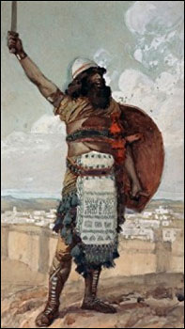
Seeking an Enduring Passion
Caleb
Part of Exodus from Egypt
One of 12 sent to spy out Canaan
One of 2 spies who argued in favour of taking the land
One of 2 from the Exodus generation to enter the land
Participated in the conquest of Canaan

Slide 6
10“Now then, just as the Lord promised, he has kept me alive for forty-five years since the time he said this to Moses, while Israel moved about in the wilderness. So here I am today, eighty-five years old! 11I am still as strong today as the day Moses sent me out; I’m just as vigorous to go out to battle now as I was then. 12Now give me this hill country that the Lord promised me that day. You yourself heard then that the Anakites were there and their cities were large and fortified, but, the Lord helping me, I will drive them out just as he said.”
- Josh 14:10-12

Slide 7
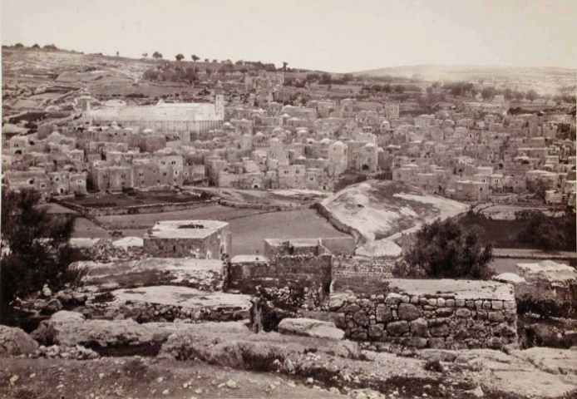
Hebron (hill country)
One of oldest continuously inhabited cities in world
27 miles south-west of Jerusalem
Inhabited by Anakites = giants
Hill country – easier to defend
Large cities = lots of defenders
Fortified defences
(Hebron 1857)

Slide 8
Give me this vision/hill country!
Defining Love, Acceptance & Forgiveness (LAF)
Love = willingness to lay down your life for another
Acceptance = receiving someone because Jesus has, no matter your personal judgment of them
Forgiveness = releasing someone from your judgment

Slide 9
Give me this vision/hill country!
Love, Acceptance & Fogiveness (LAF) = Hill Country
The world doesn’t do LAF
The world cries out for LAF
  Arland Dean Williams
  Amish Grace
  Mark Sayers
LAF is possible and inevitable
  God’s grand plan – to fill earth with His glory (His attributes on display) & one day it will fill the earth
  The Spirit is doing what He has always done
  I’m inspired to collaborate by submitting to Him

Slide 10
Response
Imagine: what would it look like if LAF was to be expressed more in your life?
Ask God to plant a seed of enduring passion for the vision
Notes:
Conclusion
Imagine - What would it look like when LAF is happening in your life?
Will you ask God to plant a seed of enduring passion for the vision? A motivational force? A great project from which you can’t come down?

